Slide 1

This meeting is being recorded
﻿﻿By joining this meeting you are providing your active consent to be recorded. If you do not give your consent you should exit the meeting and contact the meeting organizer.
﻿﻿Meeting participants are expressly prohibited from downloading or distributing the meeting recording.
﻿﻿Any screen sharing and audio/video will be part of the recording. Conversations had in the meeting via the chat window are not part of the recording.
﻿﻿Per BMS-SOP-5h "Audio, Visual and Photographic Recordings", the recording of this event has been approved by Veer Shanmugasundaram

Slide 2
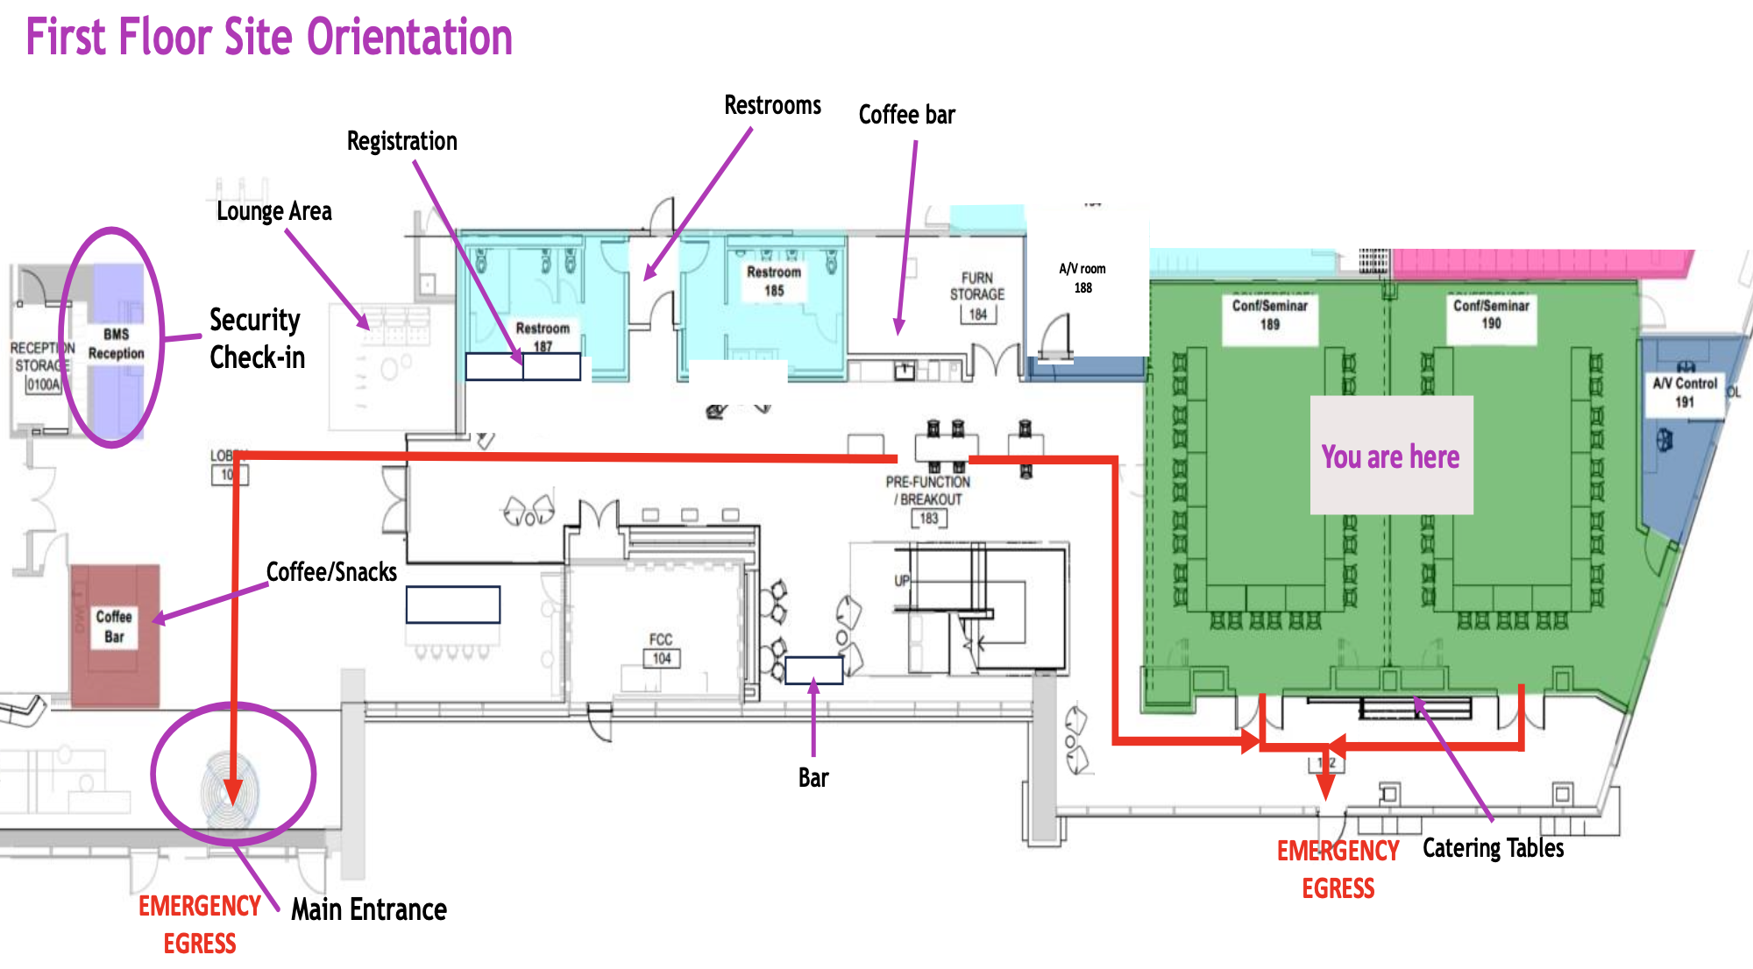

Slide 3
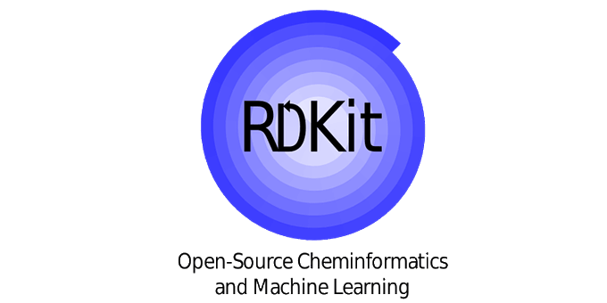

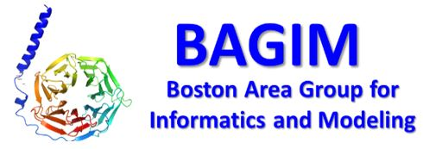









Welcome to the North American 2025 RDKit UGM!
Thank you to our sponsors!

Slide 4
2025 North America RDKit UGM
First one ever!
Thanks to BMS for hosting this event. We have a record number of signups and are grateful for the large venue!
This event would not have been possible without our generous sponsors and our amazing team.
Thanks to our moderators: Anthony Arvanitis, Jacob Speigel, Srijit Seal

Slide 5
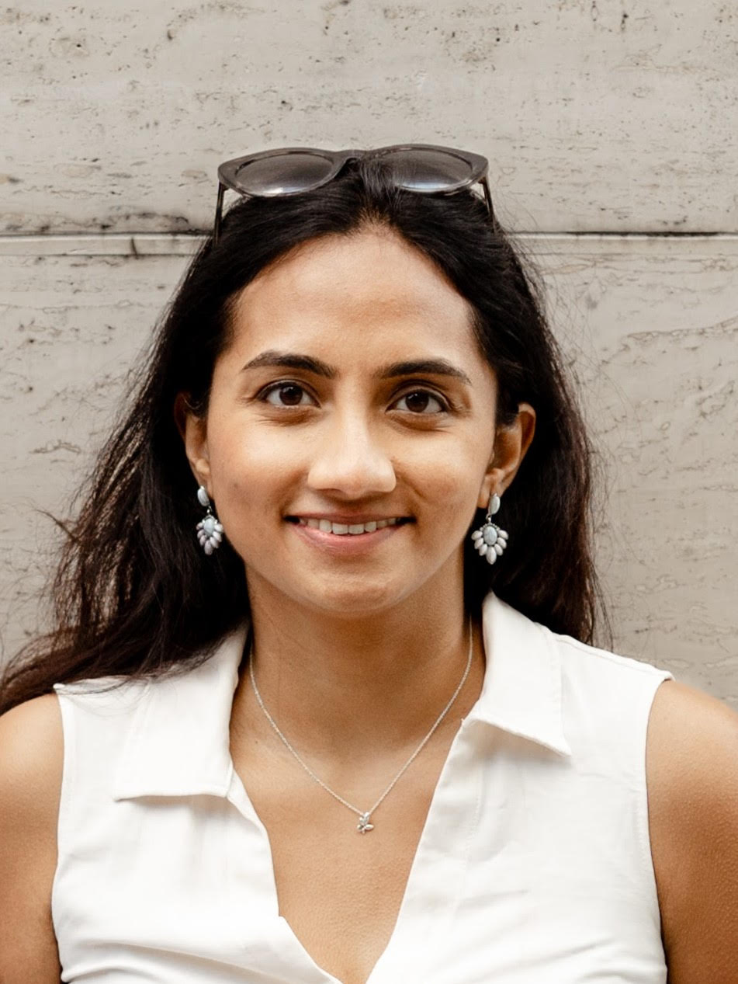
Neaan Mathai
Neann is a cheminformatician at Parabilis Medicines
She started on this path focused on public health issues such as global TB, HUB and malaria.
Then She pursued a PhD in cheminformatics under the guidance of Johannes Kirchmair. And has worked at BenevolentAI, Exscientia, and now Parabilis.

Slide 6
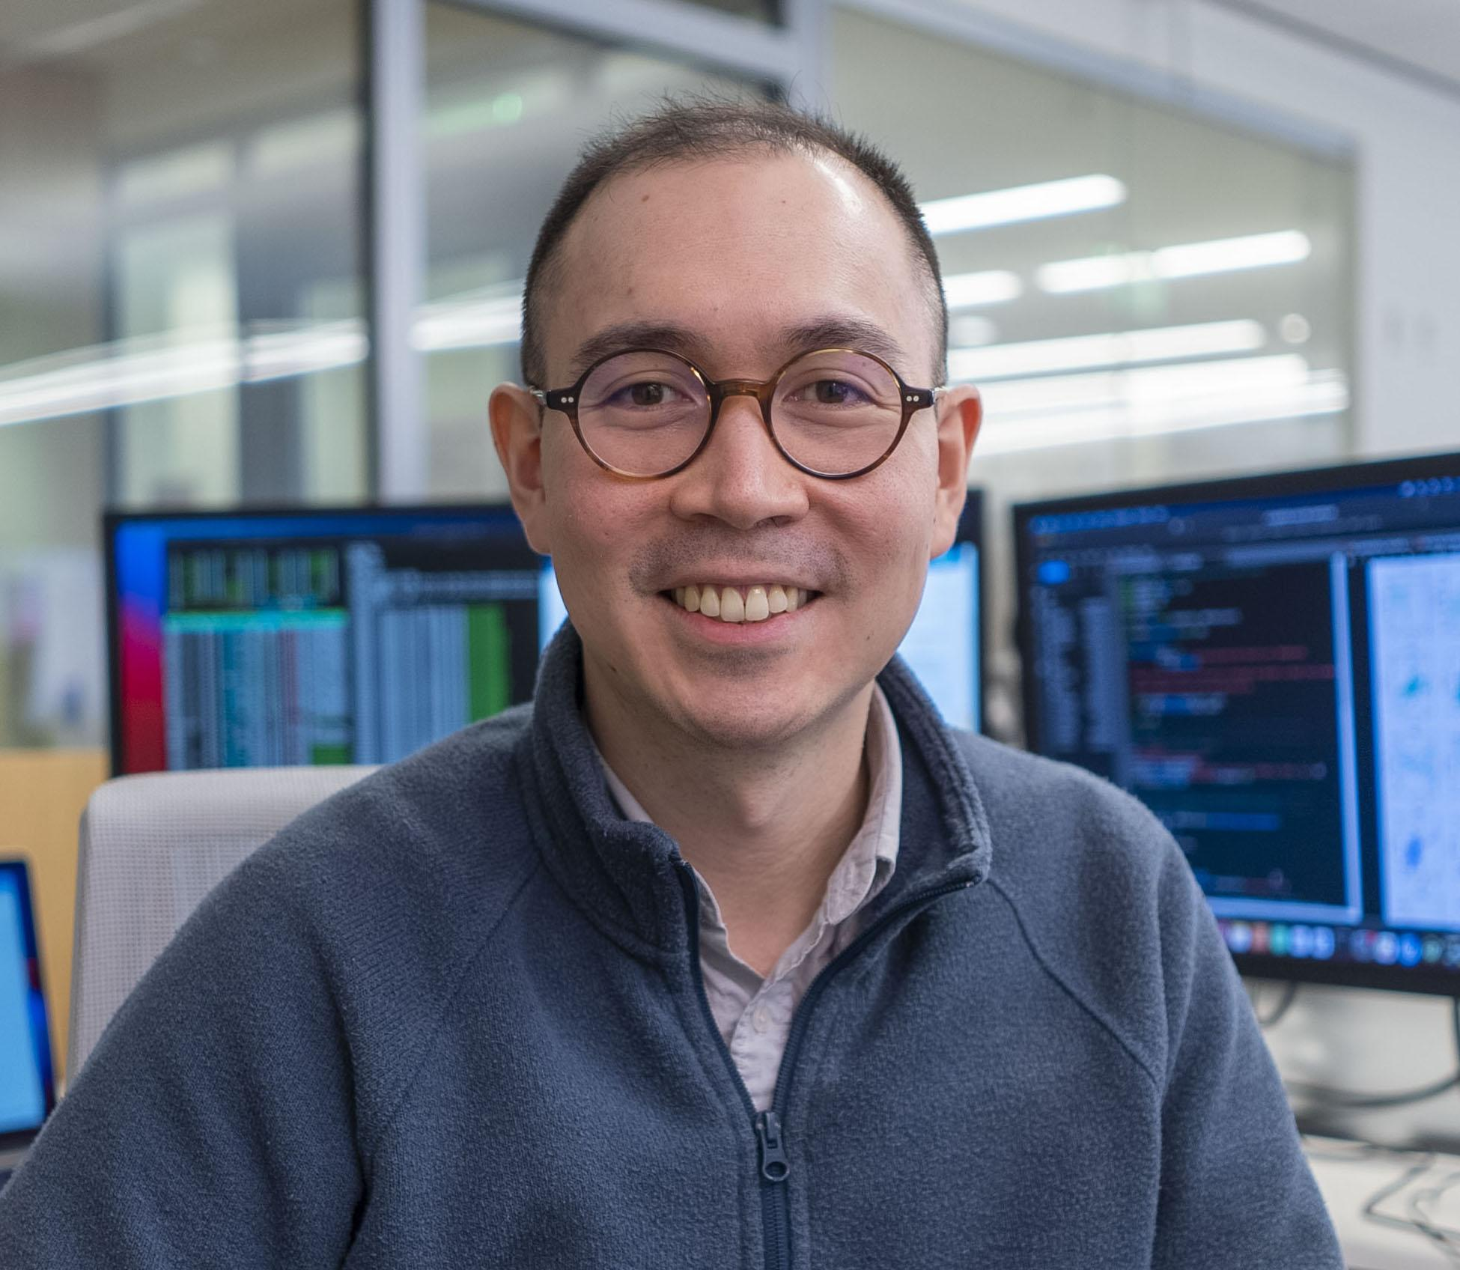
Francis Prael
Francis is currently employed at BMS where is is engaged in the Sisyphean task of using his his hybrid wet/dry background to discover medicines.
Francis received his PhD from Dave Weaver’s lab at Vanderbilt University, where he was an innumerate chemical biologist.
He then transitioned to a cheminformatics role, applying ML towards Cereblon Glue Degraders, during a Postdoc at Novartis in Cambridge, MA in Peter Kutchukian’s organization, under the direct supervision of Lingling Shen and Jutta Blank.
Francis particularly enjoys explainability and uncertainty and anything else that can help the models we use become conduits for better understanding the systems they’re trained on.

Slide 7

Before the intro
Personal note about the RDKit or “you can take it with you”.

Slide 8
Greg Goes Here

Slide 9

ChemDraw document format by Revvity
Fully open sourced ChemDraw document format.
BSD 3-clause license with no restrictions.
Integrated with the RDKit
Supports CDX/CDXML reading and writing
(Currently under code review https://github.com/rdkit/rdkit/pulls)
Funded by Revvity Inc and Glysade LLC

Slide 10
ChemDraw document format by Revvity
Why is this a big deal:
CDX is a large and complicated format, source code is essential to understanding the complexities.
This allows the format to be archived and becomes an open format.
Because it is released under the BSD license, this document reader can be used in academia and industry without restriction.
If you like reading code, this is an amazing archive of code battle tested through decades. It is a great historical archive of parsing xml.
Improves chirality support from the RDKit’s original CDXML reader

Slide 11

ChemDraw RDKit integration
Funded by Revvity and implemented by Glysade
Passes the original RDKit CDXML test suite.
Successfully round trips all RDKit test data (except 3D coords)
External 6500+ Revvity supplied CDXML test suite (not currently open sourced, tests maintained by Glysade)

Slide 12
ChemDraw RDKit integration
Limitations
Can’t write reactions (yet)
Need to add depiction support for writing reactions
HELM/Monomer support not implemented
If you are interested in adding support, contact me
3D molecules are scaled to drawing coordinates

Slide 13
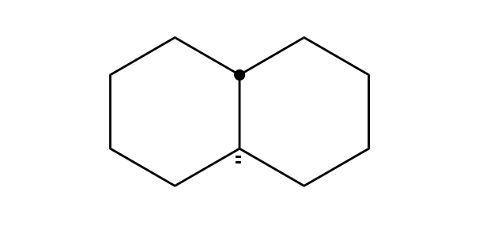
ChemDraw some fun test cases

Slide 14
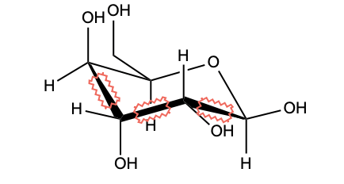
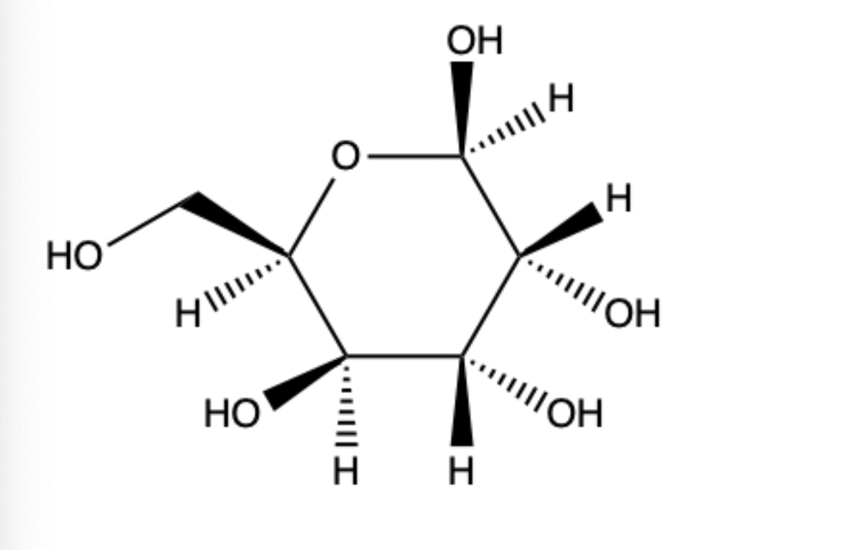
ChemDraw some fun test cases

Slide 15
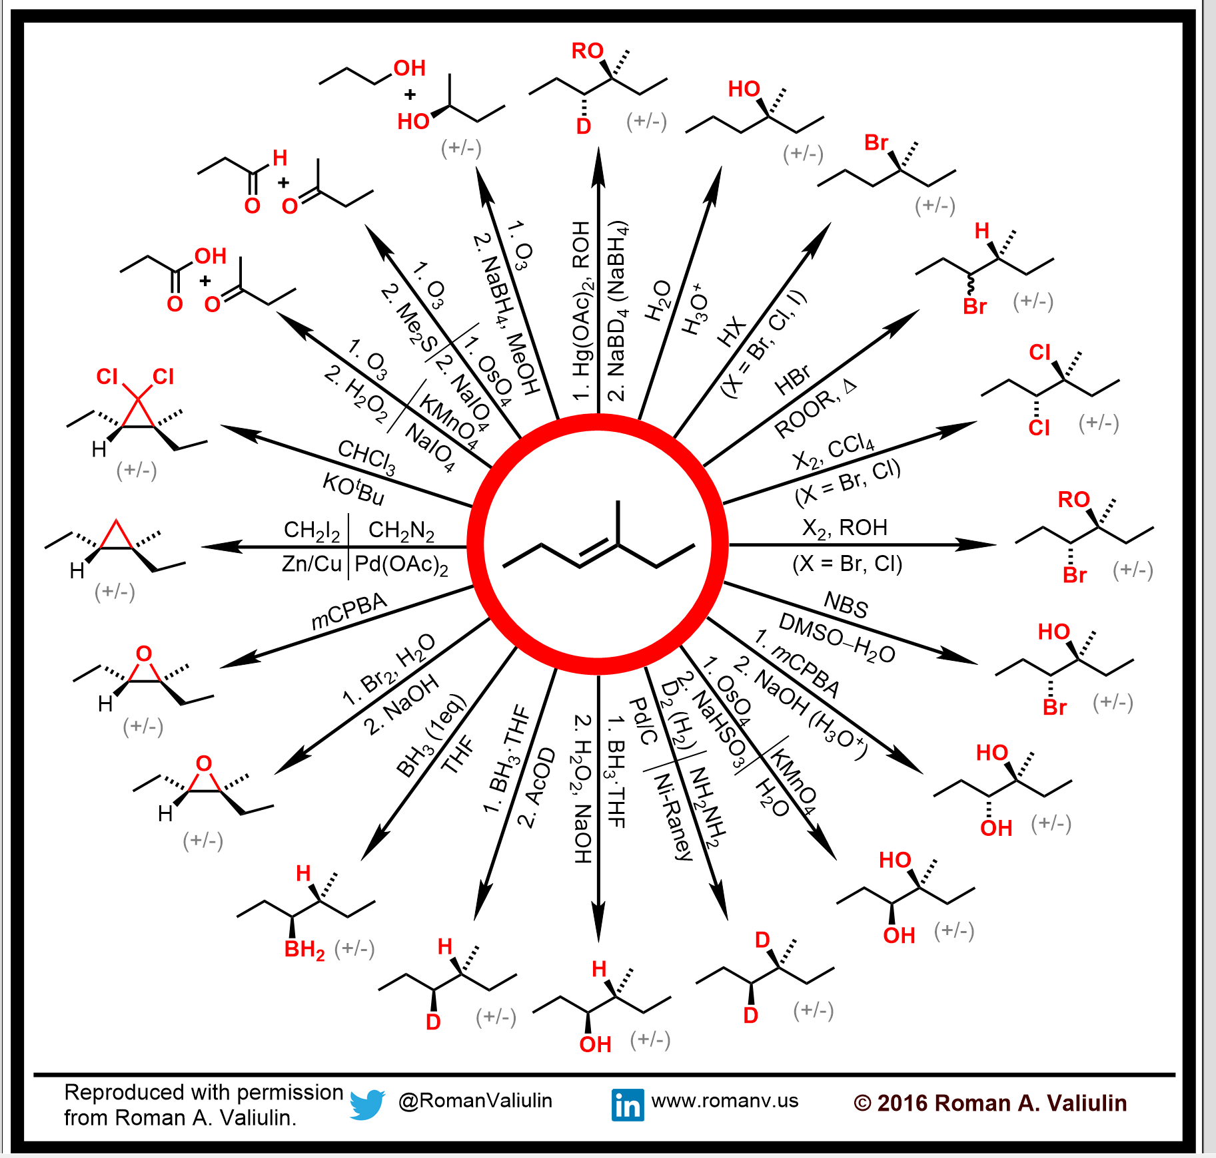
ChemDraw some fun test cases

